Slide 1

Bloom and Gloom
WBDV111 - Presentation
www.bloomandgloom.com.ph

Slide 2

Roles
Sebastian, Paul - Developer
The developer is in-charge of creating the backbone of our website. He will prepare the tags to be used by the other members as needed.
Madrid, Jamier Ivan - Quality Analyst
The QA is responsible for testing and validation of the website and report any bugs or issues found to the team members.
Peñaflor, Kent Mario - UX Design
The UX Designer is the brains that makes our website user-friendly and intuitive. They are a crucial role in enhancing the overall user experience.
Castillo, Luigi - Content Writing
The content writer would be the person to put data and images to the website itself. The role involves crafting written or visual material to help the business showcase our skills.
Suba, Alfred Cristofer - UI Design
The UI Designer collaborates with the UX Designer to create an intuitive and visually appealing interface for product design. They focus on the look and feel of the interface to ensure a seamless user experience.

Slide 3
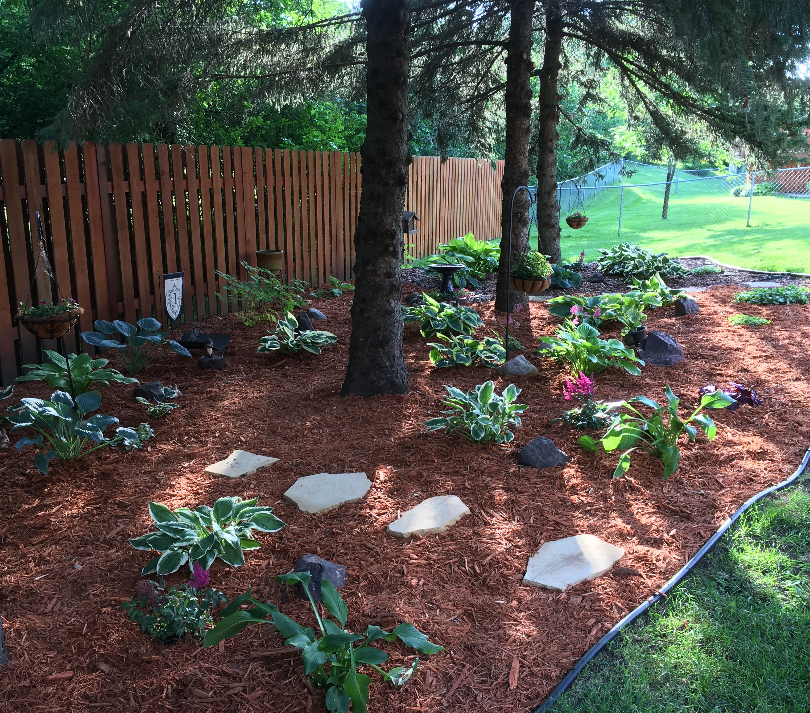
Purpose of the Website
The purpose of the Bloom and Gloom website is to provide an online platform where customers can learn about our landscaping and gardening services, view our portfolio of past projects, and schedule appointments for consultations or services.
This business website aims to showcase the quality of our work, the wide range of our services, and our commitment to customer satisfaction and environmental sustainability. It serves as a digital storefront for our business, allowing us to reach a wider audience and provide them with convenient access to our services.
In addition, the website also hosts a blog where we share gardening tips, landscaping ideas, and updates about our company. This helps us engage with our customers and the broader community, sharing our expertise and passion for landscaping and gardening.

Slide 4
Primary Logo
We’ve chosen a mix of black and white for our logo. We have changed the company name from ‘Lawn and Order’ to ‘Bloom and Gloom’

Slide 5

Homepage
“
”
We’ve added interactive gradient links for future use. This would serve as our website chart.

Slide 6
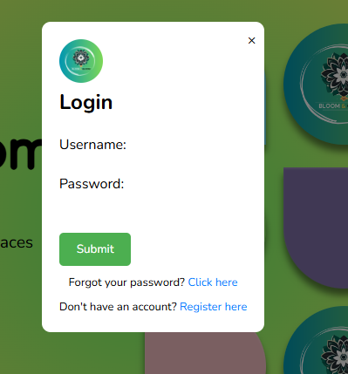
Login
“
”

Slide 7
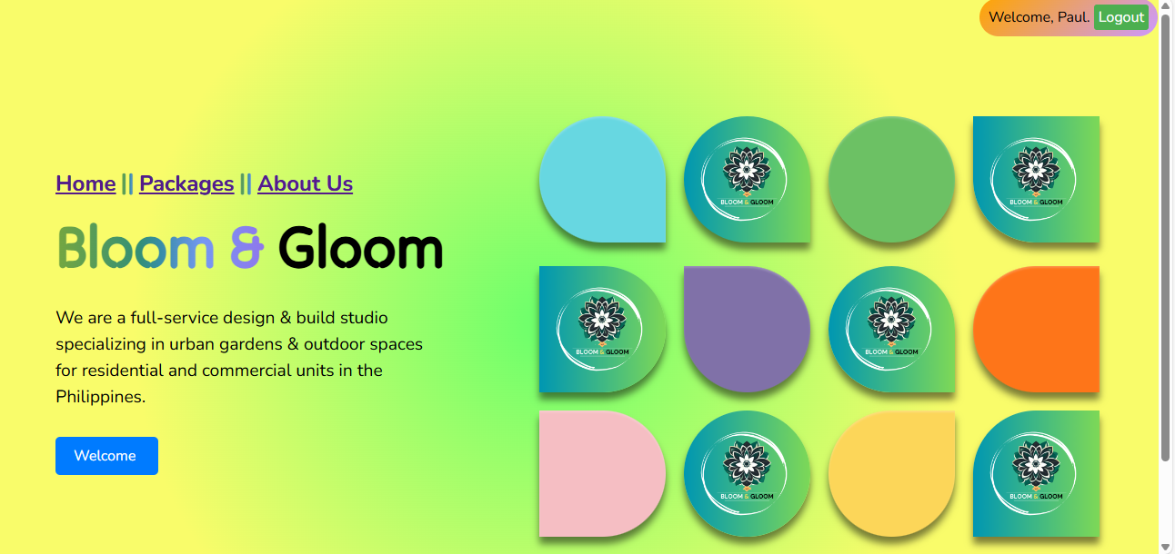
Login - Success
“
”

Slide 8
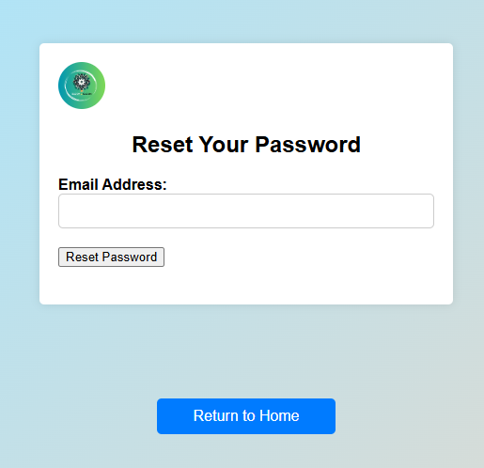
Forgot Password
“
”

Slide 9

Forgot Password - success
“
”

Slide 10
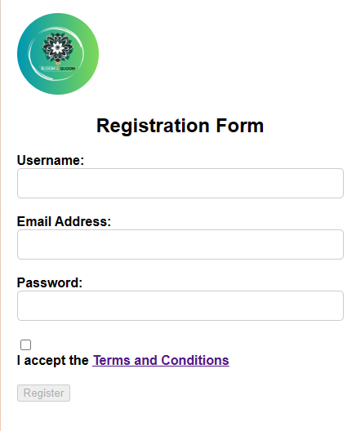
Register
“
”

Slide 11
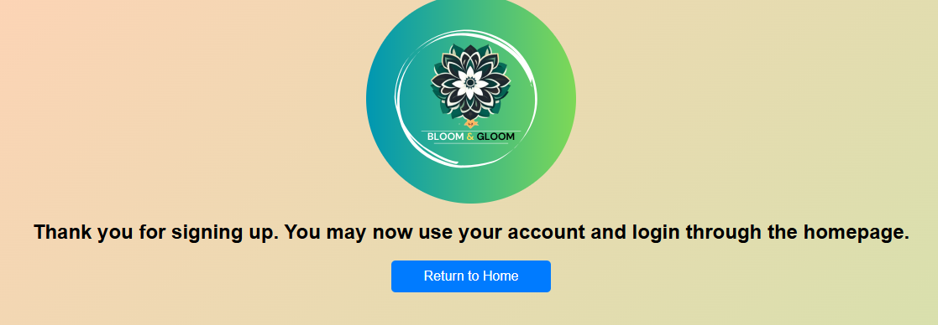
Register - complete
“
”

Slide 12
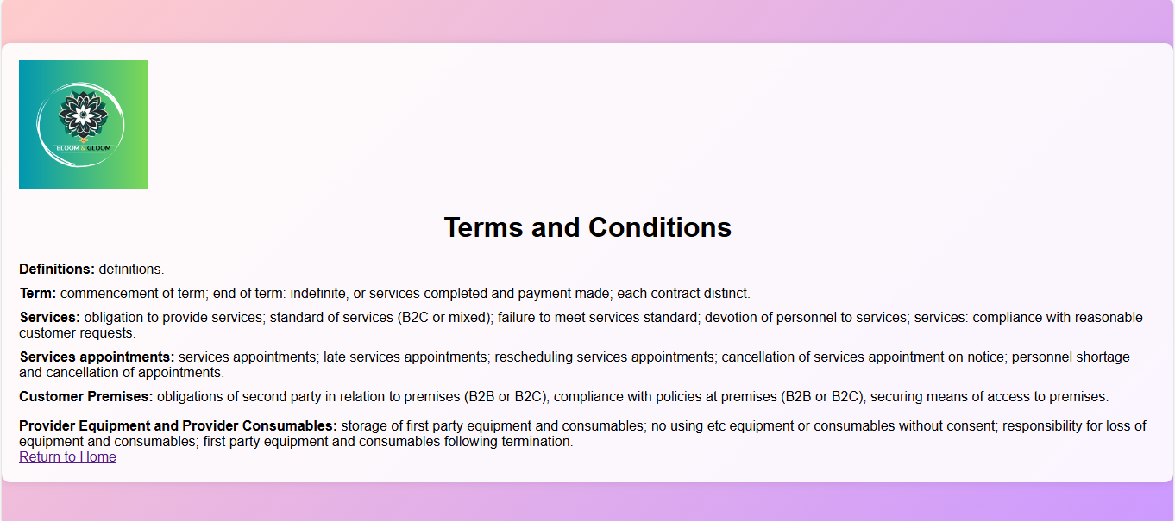
Terms and Conditions
“
”

Slide 13
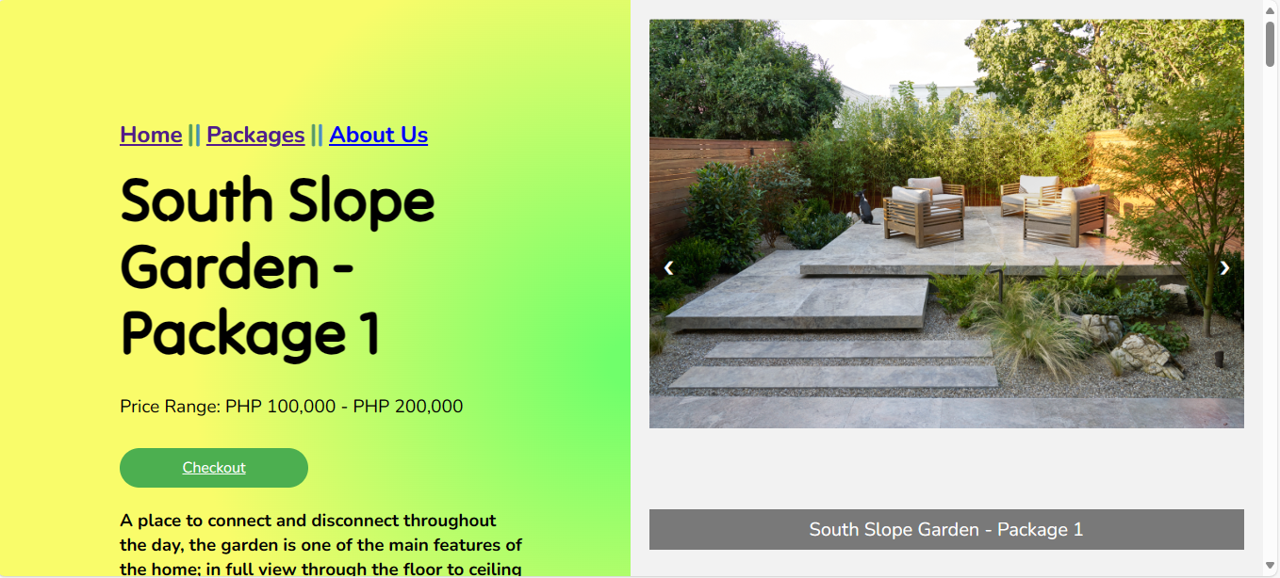
Packages

Slide 14
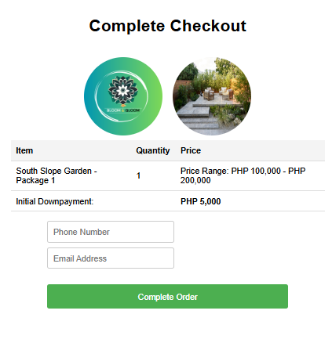
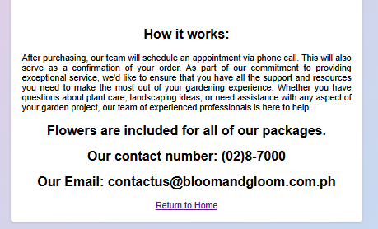
Packages - checkout

Slide 15
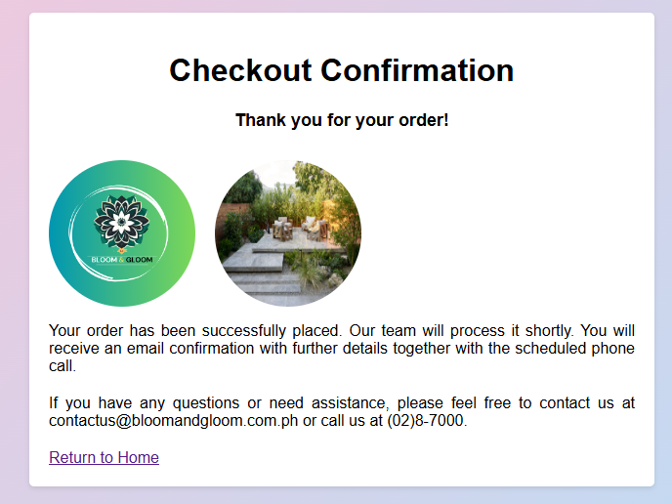
Packages – checkout complete

Slide 16
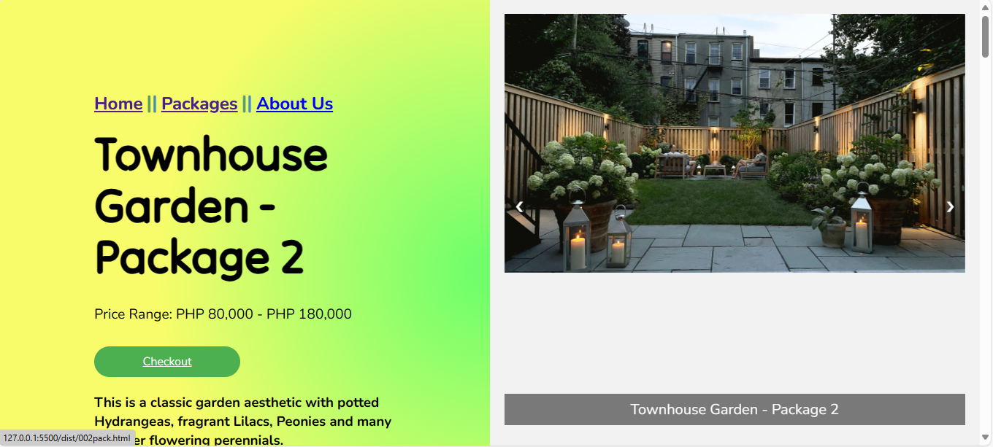
Packages

Slide 17
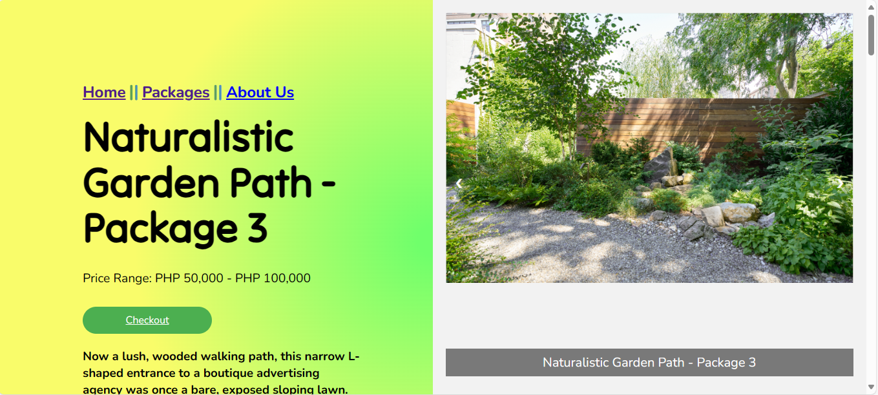
Packages

Slide 18
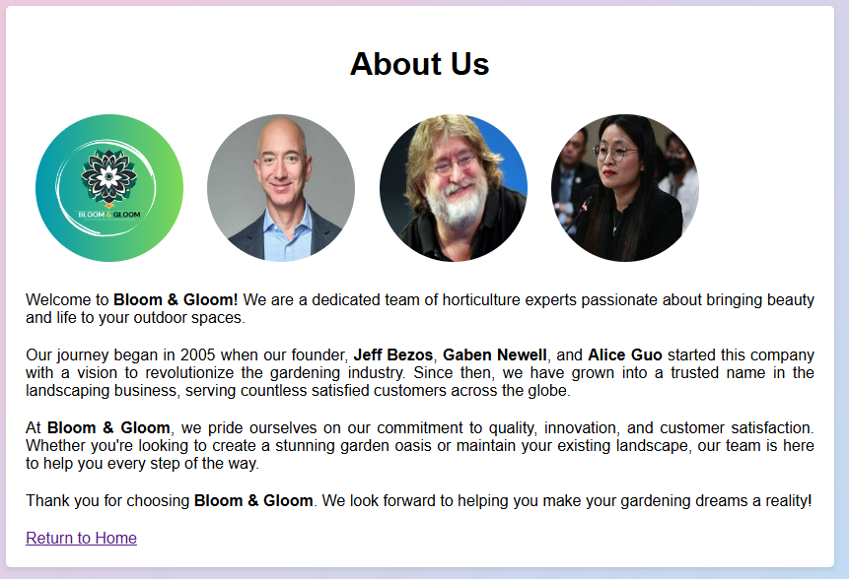
About Us

Slide 19

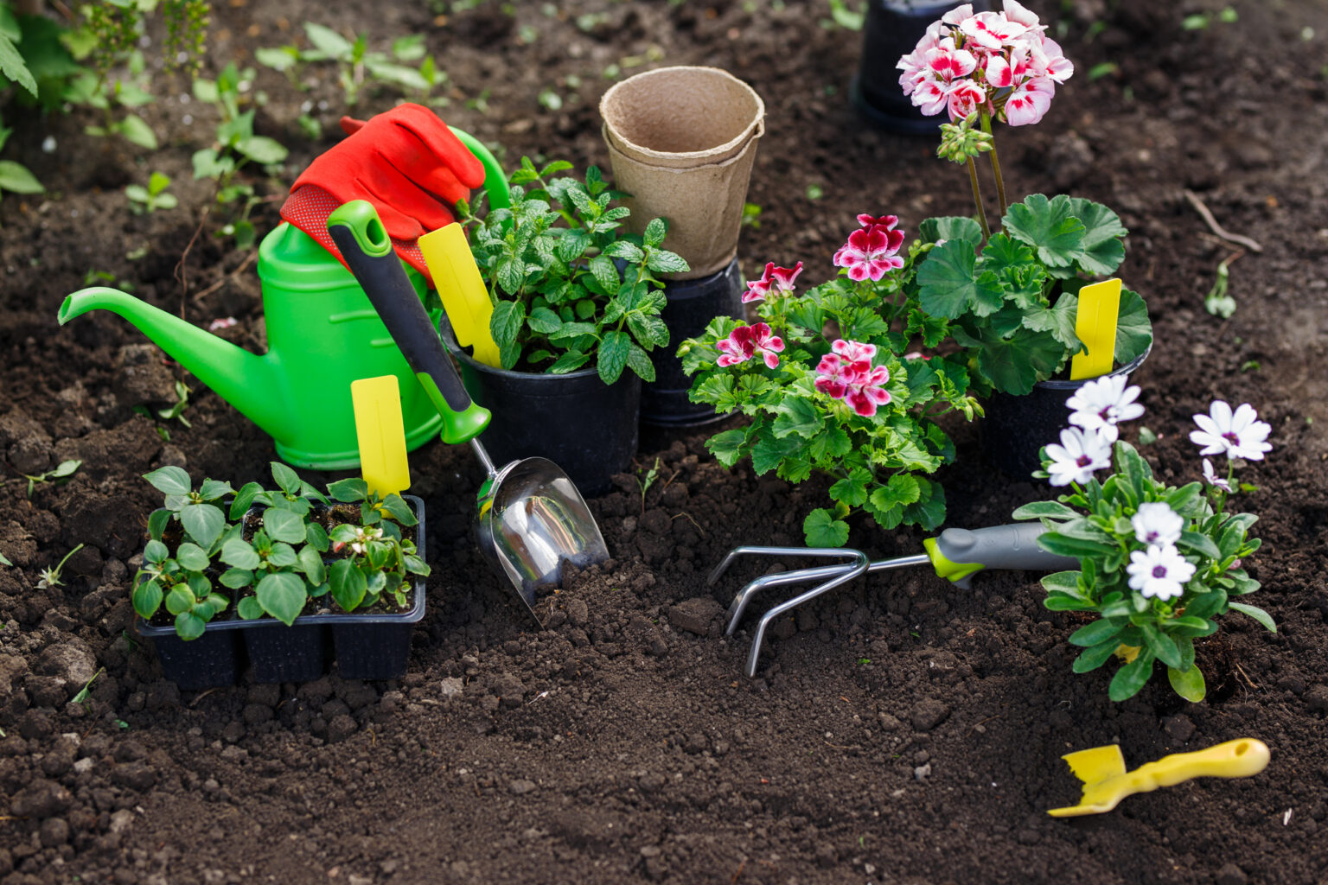


Bloom and gloom
Site Map
Bloom and Gloom
Gardening and Landscaping Services
Homepage
Packages
About Us
Checkout
Register
Company Background
Price Range
Login
Founders
How it Works
Forgot Password

Slide 20

Thank you
WBDV111 - Group 7

